Slide 1

COURSE: B.Sc. (PROGRAMME) IN ECONOMICS
PAPER NAME – MACROECONOMICS-I
TOPIC-CIRCULAR FLOW OF INCOME
YEAR- FIRST SEMESTER- 2 SESSION- 2020-2021
DATE OF LECTURE : 11/05/2021
PREPARED BY
DR. KAMALIKA CHAKRABORTY
ASSISTANT PROFESSOR (DEPARTMENT OF ECONOMICS)
KHATRA ADIBASI MAHAVIDYALAYA, BANKURA,WEST BENGAL

Slide 2
What is Circular Flow of Income?
The circular flow means the continuous flow of production of goods and services, income, and expenditure in an economy. It shows the redistribution of income in a circular manner between the production unit and households.
The four factors of production are land, labour, capital, and entrepreneurship.
The payment for the contribution made by fixed natural resources (called land) is known as rent.
The payment for the contribution made by a human worker is known as wage.
The payment for the contribution made by capital is known as interest.
The payment for the contribution made by entrepreneurship is known as profit.

Slide 3
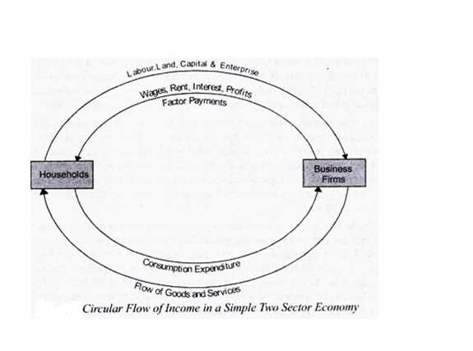
Circular Flow of Income in a Two-Sector Economy
It is defined as the flow of payments and receipts for goods, services, and factor services between the households and the firm sectors of the economy.
Total expenditure (E) = C + I
Total income (Y) = C + S

Slide 4
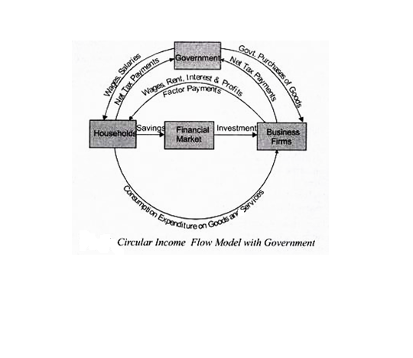
Circular Flow of Income in a Three-Sector Economy
It is defined as the flow of payments and receipts for goods, services, and factor services among the households, the firm sectors and the government.
Total expenditure (E) = C + I + G
Total income (Y) = C + S + T
Since expenditure incurred must be equal to the income received (Y), we have C + I = C + S
or, I = S

Slide 5
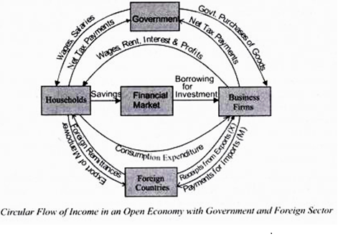
Circular Flow of Income in a Four-Sector Economy
It is defined as the flow of payments and receipts for goods, services, and factor services among the households, the firm sectors ,the government and the foreign sector.
National Income = C + I + G + NX where NX represents net exports, X-M. Since national income can be either consumed, saved or paid as taxes to the Government we have
C + I + G + NX = C + S + T

Slide 6
THANK YOU

